Slide 1
SUSTAINABILITY AND PERSONAL FINANCE
LIVING THE COMMITMENT
Money Math: Adding up savings & watching it grow.
SAVE | PROTECT | GROW
SAMUEL MATEKHA SHIKHONGOLA
Head Marketing and Communication
Diamond Trust Bank

Slide 2
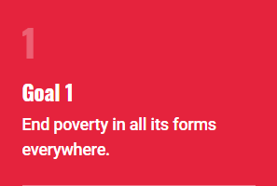
SDGS AND PERSONAL FINANCE
SUSTAINABILITY
Others
Zero Hunger
Good health and wellbeing
Quality Education
Gender equality
Clean water and sanitation
Affordable and clean energy
Decent work and economic growth
Industry Innovations and Infrastructure
Reduced Inequalities
Sustainable cities and communities
Responsible consumption and production
Climate action
Life below water
Life on land
Peace, Justice and strong institutions
Partnership for the goals
SUSTAINABILITY AND PERSONAL FINANCE – LIVING THE COMMITMENT

Slide 3
SUSTAINABILITY
KEY DEFINIATIONS
Practices and habits that promote your long-term well being, resilience and environmental responsibility.
Environmental sustainability – Nature and your surroundings
Social sustainability – Personal growth, value alignment, mental health & relationships.
Economic sustainability – Financial management, personal development & long-term security
PERSONAL FINANCE
Management of resources to achieve financial stability as per set goal and objectives.
Goals – Independence – wealth creation, Debit freedom
Value optimization – Work and generating income
Budgeting – Expenditure, Savings, Investments, Borrowing, Risk Management and Future
Living a life – Life choices for happiness or the other side.
COMMITMENT
Living and actioning set promises to achieve certain objectives.
Short-term - Debit repayment, emergency etc
Long-term – Retirement, investment, insurance, marriage etc
Recuring – Monthly bills, Subscription service, loan repayment among others
SUSTAINABILITY AND PERSONAL FINANCE – LIVING THE COMMITMENT

Slide 4
PERSONAL DRIVERS
GOALS / OBJECTIVES
“Setting goals is the first step in turning the invisible into the visible.” – Tony Robbins
“You are never too old to set a new goal or dream a new dream.” – C.S. Lewis
Personal goals - Physical health &wellness, mental well being, personal growth and self awareness.
Career goals – Professional development, work life balance, leadership and impact.
Education goals – Academic achievements, research and innovation.
Emotional goals – Resilience and stress management, happiness and fulfillment.
Spiritual goals – Inner peace and harmony, purpose and meaning.
Financial goals – Savings and investing, retirement planning, wealth creation and legacy, Financial independence.
SUSTAINABILITY AND PERSONAL FINANCE – LIVING THE COMMITMENT

Slide 5
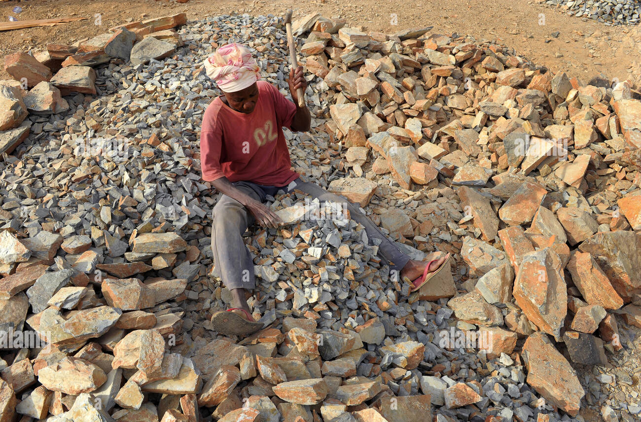
RESOURCE OPTIMISATION FOR PESONAL FINANCE
PERSONAL FINANCE
Work and maximize return from all you do. Know what your surrounding wants//needs. Can you add value to them? Can you satisfy the demands?
Life
Complete body
Land / Property
Housing
Skill
Talent
etc
What can you offer?
“A dream doesn’t become reality through magic; it takes sweat, determination and hard work.” – Colin Powell
SUSTAINABILITY AND PERSONAL FINANCE – LIVING THE COMMITMENT

Slide 6
MANAGING INCOME AND EXPENSES
BUDGETING
Effective management of personal income and budget is crucial for financial stability, Security and achieving both long term and short-term goals
Income management
Track income - salary/wages and other sources
Create budgets – allocate income to categories
Prioritize needs – essentials and nonessentials.
Keep eyes on the goal.
Budgeting
Apply a rule e.g. 50/30/20 rule – Necessities, food and entertainment.
Know and categorize expenses – Housing, food
Review regularly and adjust budget- book keep.
Keep eyes on the goal.
SUSTAINABILITY AND PERSONAL FINANCE – LIVING THE COMMITMENT

Slide 7
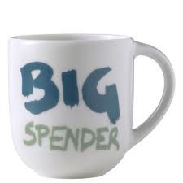
HABITS TAKING OUR MONEY
WHY WE SPEND MORE
My friend does and has this.
Consumption of non-essential items (beverages, snacks, luxuries).
Spending more on parties and festivals.
High expenses on life events such as marriages and funerals.
Purchase in small quantities of necessities at high costs.
No planning ahead as we go to consume.
We love credit.
We carry big cash.
SUSTAINABILITY AND PERSONAL FINANCE – LIVING THE COMMITMENT

Slide 8
SPENDING VS SAVING
“Do not save what is left after spending, but spend what is left after saving.”- Warren Buffett
SUSTAINABILITY AND PERSONAL FINANCE – LIVING THE COMMITMENT

Slide 9
THOUGHTS ON SAVINGS
SAVING
The days of a safe secure job are behind us...
Salary is an invitation into the club of the wealthy but …
Betting on children to provide for at retirement is a gamble; Retirement period equals employment one
After 45 years, it’s job to ‘career’, ‘calling’ and legacy;
Take 100% responsibility for your future;
Start with on-going projects; passive income;
Know key success factors for business: once started, remain on edge, set a goal…
SUSTAINABILITY AND PERSONAL FINANCE – LIVING THE COMMITMENT

Slide 10
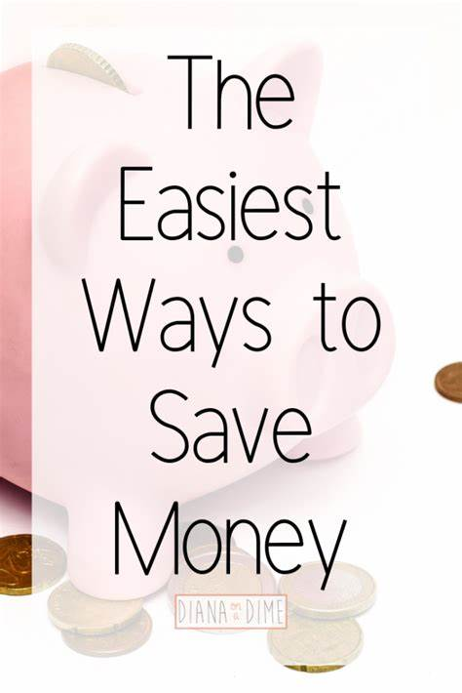
The money/ an item set aside for future use and not spent immediately. Saving can be used to accomplish objectives in the short-term, medium term and long term.
SAVING
TIPS ON SAVINGS
Bank accounts
Property
Bonds and Bills
ETC
SAVINGS PARTNERS
Banks
Friends
Groups
SUSTAINABILITY AND PERSONAL FINANCE – LIVING THE COMMITMENT

Slide 11
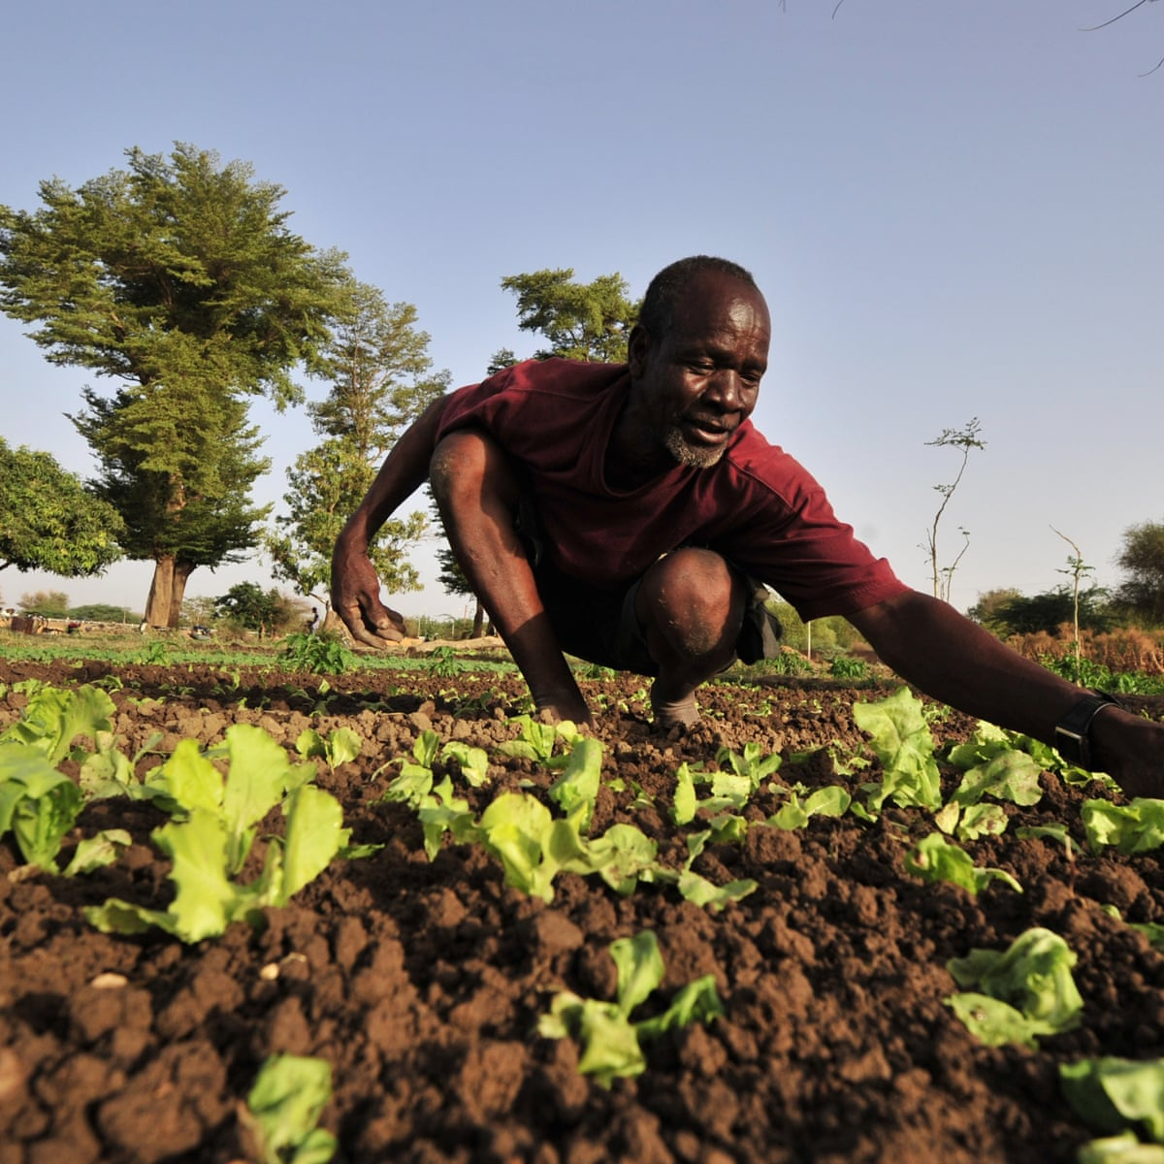
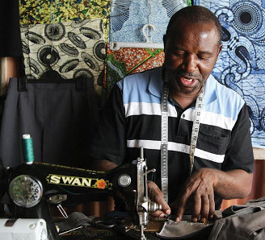
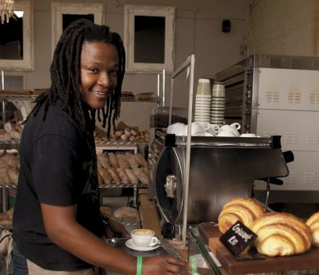
INVESTMENT TIPS FOR BEGINNERS
INVESTMENT
Investing is one of the best ways to see solid returns on your money.
How much you should invest depends on your financial situation, investment goal and when you need to reach it.
Pick an investment strategy that makes sense for your saving goals, how much you're investing and your time horizon.
Understand your investment choices /options— such as Term deposits, Insurance, recurring deposits, stocks, bonds and bills, business, property, education, personality — to build a portfolio for your goals.
Start investing as early as possible.
SUSTAINABILITY AND PERSONAL FINANCE – LIVING THE COMMITMENT

Slide 12
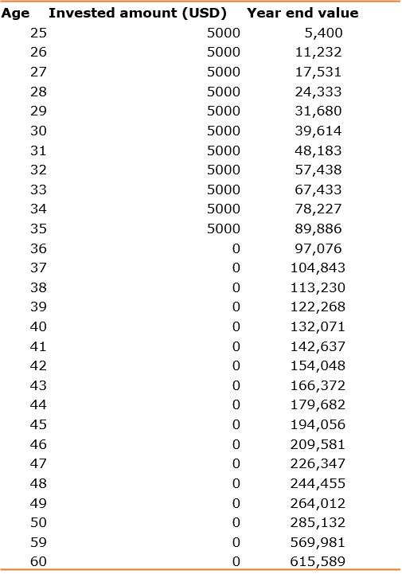
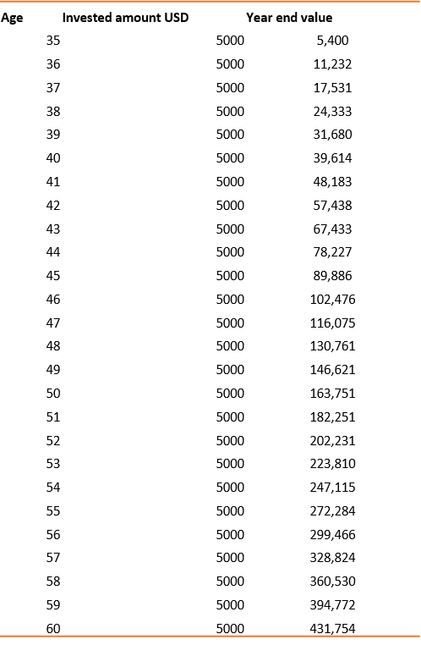
MONEY MATH – THE EARLIER THE BETTER
INVESTMENT TIME
Interest calculated at 8% per annum
Invested $ 55,000
Final retirement Value - $615,580
Invested $ 130,000
Final retirement Value - $431,754
SUSTAINABILITY AND PERSONAL FINANCE – LIVING THE COMMITMENT

Slide 13
YOUR TASK/ RESPONSIBILITIES
That your problems are yours
That you are the best solution to your problems – not government, not the bank, not landlord and not your spouse…
The school fees problem is relative… you pick your choice
That the law won’t change today to give you money… but you can change your money habits today
That wealth is habits, attitudes, behavior, and 5% money. You should stop looking for money and start making money
You grew up eating other people’s money…. you would plan for the next generation ton eat your money – don’t be selfish
If you don’t save money… money won’t save you
SUSTAINABILITY AND PERSONAL FINANCE – LIVING THE COMMITMENT

Slide 14
THANK YOU

